Slide 1




Slide 2


Transaction Processing Concepts - overview of concurrency control, Transaction Model, Significance of concurrency Control & Recovery, Transaction States, System Log, Desirable Properties of transactions.
Serial schedules, Concurrent and Serializable Schedules, Conflict equivalence and conflict serializability, Recoverable and cascade-less schedules, Locking, Two-phase locking and its variations. Log-based recovery, Deferred database modification, check-pointing.
Introduction to NoSQL Databases, Main characteristics of Key-value DB (examples from: Redis), Document DB (examples from: MongoDB)
Main characteristics of Column - Family DB (examples from: Cassandra) and Graph DB (examples from : ArangoDB)

Slide 3
Introduction to NoSQL Databases

Slide 4

NoSQL database stands for “Not Only SQL” or “Not SQL.”
It is a non-relational Data Management System, that does not require a fixed schema.
It avoids joins, and is easy to scale. The major purpose of using a NoSQL database is for distributed data stores with humongous data storage needs.
NoSQL is used for Big data and real-time web apps.
For example, companies like Twitter, Facebook and Google collect terabytes of user data every single day.

Slide 5
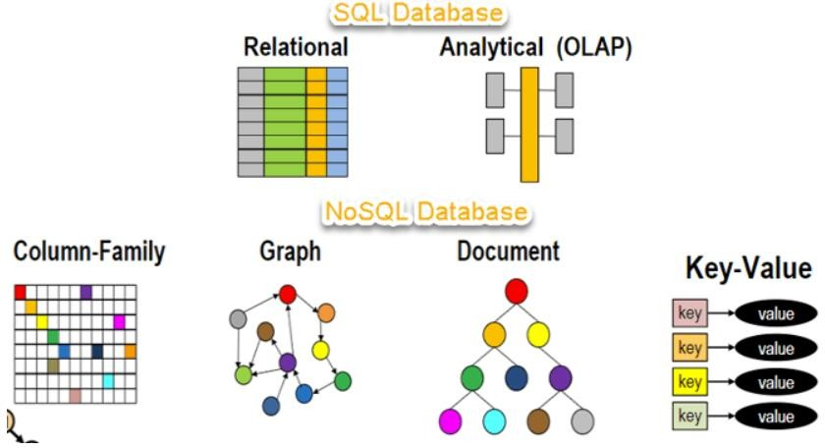

Slide 6

The concept of NoSQL databases became popular with Internet giants like Google, Facebook, Amazon, etc. who deal with huge volumes of data.
The system response time becomes slow when you use RDBMS for
massive volumes of data.
To resolve this problem, we could “scale up” our systems by upgrading our existing hardware. This process is expensive.
The alternative for this issue is to distribute database load on multiple
hosts whenever the load increases. This method is known as “scaling out.”
NoSQL database is non-relational, so it scales out better than relational
databases as they are designed with web applications in mind.

Slide 7
1998- Carlo Strozzi use the term NoSQL for his lightweight, open-source relational database
2000- Graph database Neo4j is launched
2004- Google BigTable is launched
2005- CouchDB is launched
2007- The research paper on Amazon Dynamo is released
2008- Facebooks open sources the Cassandra project
2009- The term NoSQL was reintroduced

Slide 8

Non-relational
NoSQL databases never follow the relational model
Never provide tables with flat fixed-column records
Work with self-contained aggregates or BLOBs
Doesn’t require object-relational mapping and data normalization
No complex features like query languages, query planners,referential integrity joins, ACID
Schema-free
NoSQL databases are either schema-free or have relaxed schemas
Do not require any sort of definition of the schema of the data
Offers heterogeneous structures of data in the same domain

Slide 9
Simple API
Offers easy to use interfaces for storage and querying data provided
APIs allow low-level data manipulation & selection methods
Text-based protocols mostly used with HTTP REST with JSON
Mostly used no standard based NoSQL query language
Web-enabled databases running as internet-facing services
Distributed
Multiple NoSQL databases can be executed in a distributed fashion
Offers auto-scaling and fail-over capabilities
Often ACID concept can be sacrificed for scalability and throughput
Mostly no synchronous replication between distributed nodes Asynchronous Multi- Master Replication, peer-to-peer, HDFS Replication
Only providing eventual consistency
Shared Nothing Architecture. This enables less coordination and higher distribution.

Slide 10
NoSQL Databases are mainly categorized into four types:
Key-value Pair Based
Column-oriented
Graphs based
Document-oriented

Slide 11



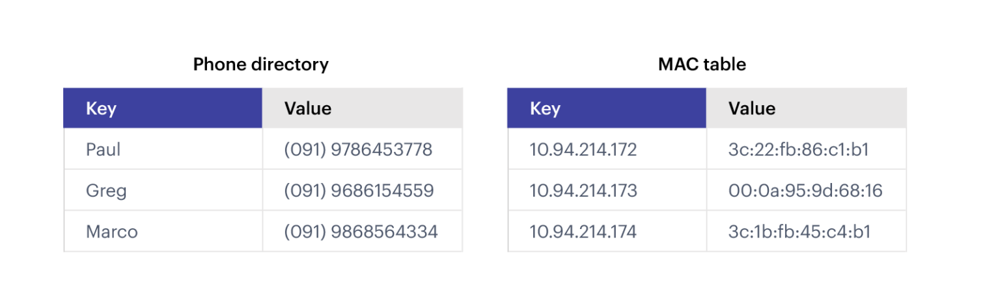
A key-value database (sometimes called a key-value store) uses a simple key-value method to store data.
These databases contain a simple string (the key) that is always unique and an arbitrary large data field (the value).
They are easy to design and implement.

Slide 12
As the name suggests, this type of NoSQL database implements a hash table to store unique keys along with the pointers to the corresponding data values.
The values can be of scalar data types such as integers or complex structures such as JSON, lists, BLOB, and so on.
A value can be stored as an integer, a string, JSON, or an array—with a key
used to reference that value.
It typically offers excellent performance and can be optimized to fit an organization’s needs.
Key-value stores have no query language but they do provide a way to add and remove key-value pairs.
Values cannot be queried or searched upon. Only the key can be queried.

Slide 13
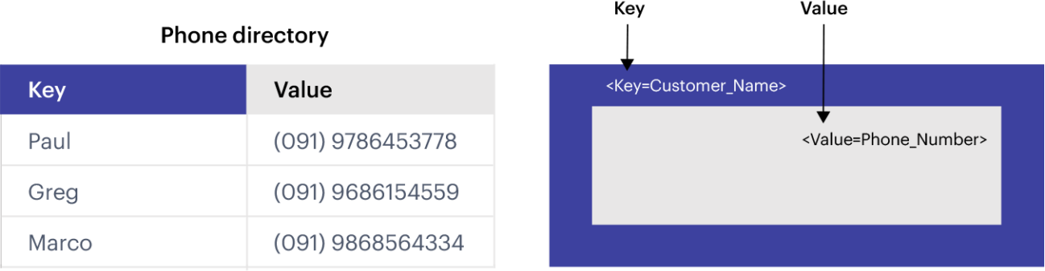
A simple example of key-value data store.

Slide 14


When your application needs to handle lots of small continuous reads and writes, that may be volatile. Key-value databases offer fast in-memory access.
When storing basic information, such as customer details; storing webpages with the URL as the key and the webpage as the value; storing shopping-cart contents, product categories, e-commerce product details
For applications that don’t require frequent updates or need to support complex queries.

Slide 15


Session management on a large scale.
Using cache to accelerate application responses.
Storing personal data on specific users.
Product recommendations, storing personalized lists of items for individual customers.
Managing each player’s session in massive multiplayer online games.
Redis, Dynamo, Riak are some NoSQL examples of key-value store DataBases.

Slide 16


While a relational database stores data in rows and reads data row by row, a column store is organized as a set of columns.
When you want to run analytics on a small number of columns, you can read those columns directly without consuming memory with the unwanted data.
Columns are often of the same type and benefit from more efficient
compression, making reads even faster.
Columnar databases can quickly aggregate the value of a given column (adding up the total sales for the year, for example). Use cases include analytics.

Slide 17
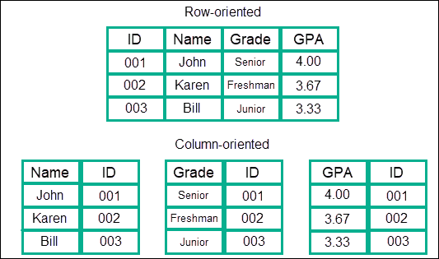

Slide 18
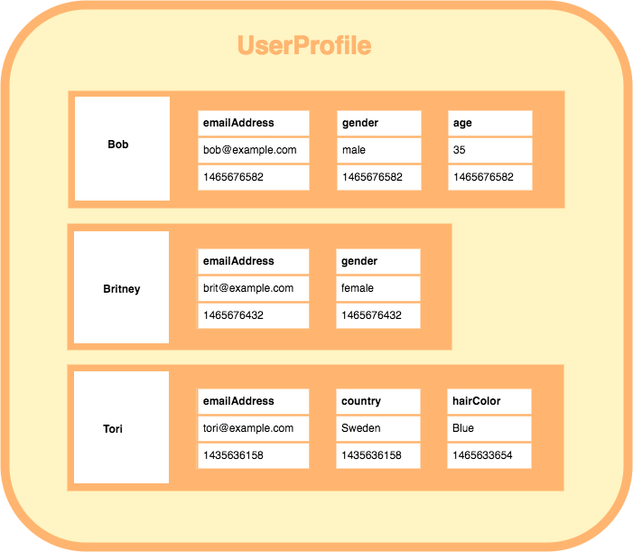
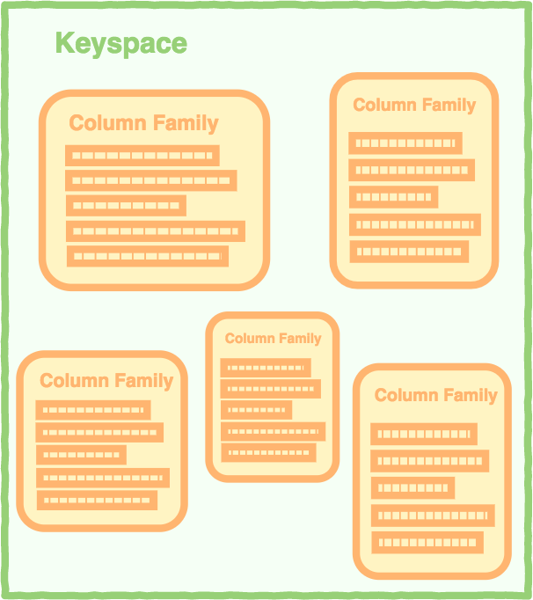
Column databases use the concept of keyspace, which is sort of like a schema in relational models.
This keyspace contains all the column families, which then contain rows, which then contain columns.

Slide 19
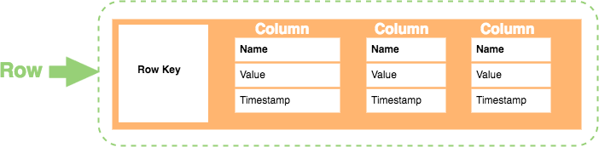
If we take a specific row as an example:
The Row Key is exactly that: the specific identifier of that row and is always unique.
The column contains the name, value, and timestamp, so that’s straightforward. The name/value pair is also straight forward, and the timestamp is the date and time the data was entered into the database.
Some examples of column-store databases include Casandra, CosmoDB, Bigtable, and HBase.

Slide 20
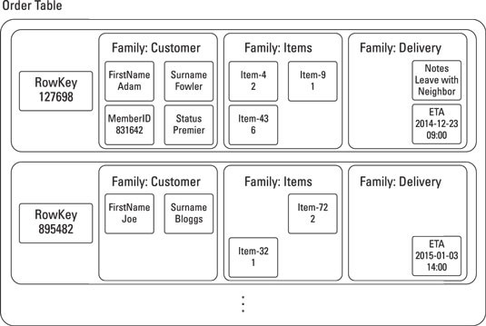

Slide 21


Developers mainly use column databases in:
Content management systems
Blogging platforms
Systems that maintain counters
Services that have expiring usage
Systems that require heavy write requests (like log aggregators)

Slide 22
There are several benefits that go along with columnar databases:
Column stores are excellent at compression and therefore are efficient in terms of
storage.
You can reduce disk resources while holding massive amounts of information in a single column
Since a majority of the information is stored in a column, aggregation queries are quite fast, which is important for projects that require large amounts of queries in a small amount of time.
Scalability is excellent with column-store databases.
They can be expanded nearly infinitely, and are often spread across large clusters of
machines, even numbering in thousands.
That also means that they are great for Massive Parallel Processing

Slide 23
Load times are similarly excellent, as you can easily load a billion-row table in a few seconds.
You can load and query nearly instantly.
Large amounts of flexibility as columns do not necessarily have to look like each other.
You can add new and different columns without disrupting the whole database.

Slide 24


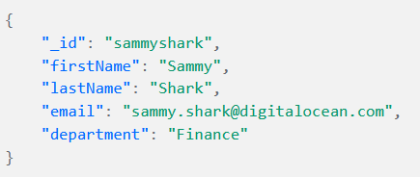
Is a modernized way of storing data as JSON rather than basic columns/rows — i.e. storing data in its native form.
This storage system lets you retrieve, store, and manage document- oriented information
It’s a very popular category of modern NoSQL databases, used by the likes of MongoDB, Cosmos DB, DocumentDB, SimpleDB, PostgreSQL, OrientDB, Elasticsearch and RavenDB.
This is an example of a document that might appear in a
document database like MongoDB.
This sample document represents a company contact card, describing an employee called Sammy:

Slide 25
Notice that the document is written as a JSON object.
JSON is a human-readable data format that has become quite popular in recent years.
While many different formats can be used to represent data within a document database, such as XML or YAML, JSON is one of the most common choices.
For example, MongoDB adopted JSON as the primary data format to define and
manage data.

Slide 26



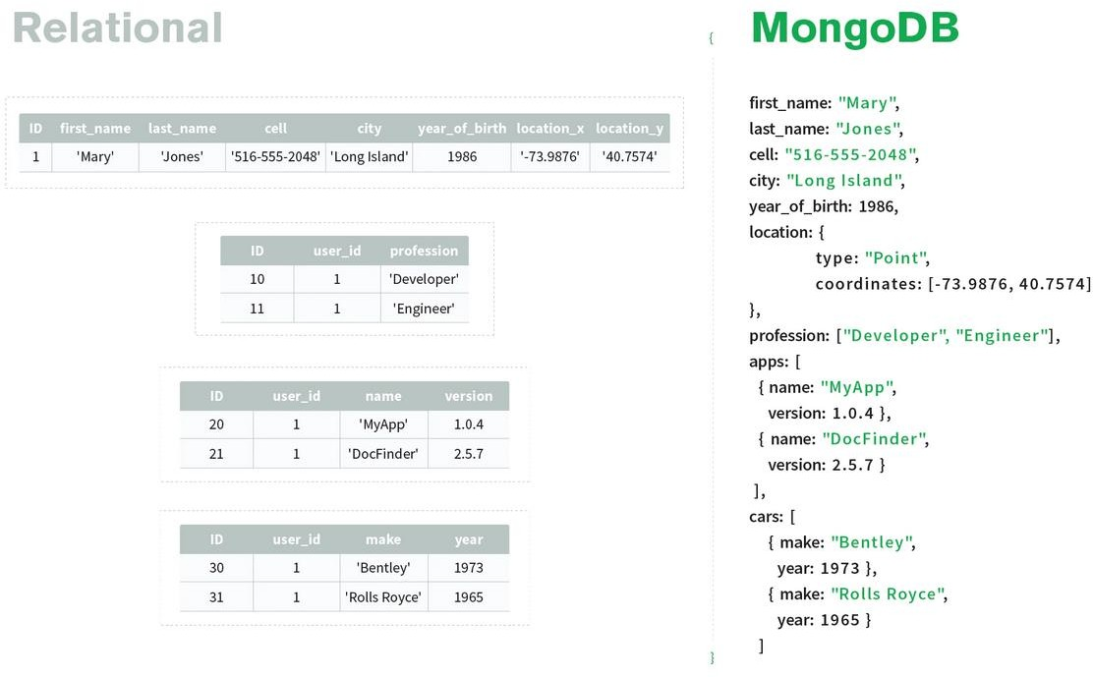

Slide 27
A few of the most important benefits are:
Flexibility and adaptability: with a high level of control over the data structure, document databases enable experimentation and adaptation to new emerging requirements.
New fields can be added right away and existing ones can be changed any time.
It’s up to the developer to decide whether old documents must be amended or the
change can be implemented only going forward.
Ability to manage structured and unstructured data: Document databases can be used to handle structured data as well, but they’re also quite useful for storing unstructured data where necessary.
Scalability by design: Conversely, document databases are designed as distributed systems that instead allow you to scale horizontally (meaning that you split a single database up across multiple servers).

Slide 28



Graph databases are generally straightforward in how they’re structured though. They primarily are composed of two components:
The Node
This is the actual piece of data itself.
It can be the number of viewers of a youtube video, the number of people who have read a tweet, or it could even be basic information such as people’s names, addresses, and so forth.
The Edge
This explains the actual relationship between two nodes.
Interestingly enough, edges can also have their own pieces of information, such as the nature of the relation between two nodes. Similarly, edges might also have directions describing the flow of said data.

Slide 29
With the advent of the NoSQL movement, businesses of all sizes have a variety of modern options from which to build solutions relevant to their use cases.
Calculating average income? Ask a relational database.
Building a shopping cart? Use a key-value Store.
Storing structured product information? Store as a document.
Describing how a user got from point A to point B? Follow a graph.
Examples of Graph Databases
Neo4j, ArangoDB

Slide 30
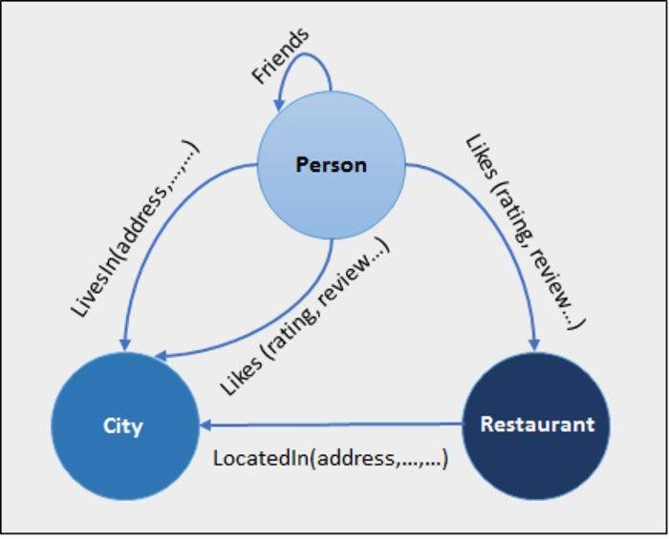
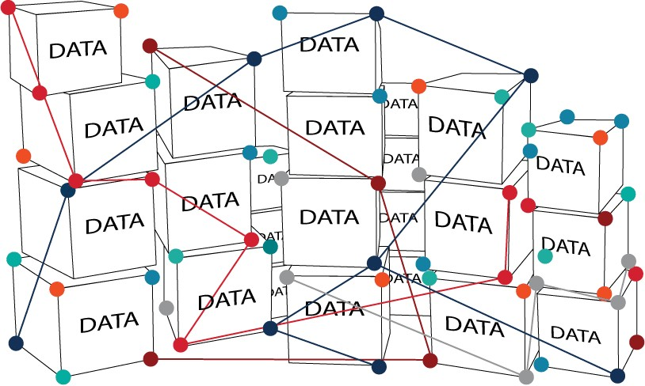

Slide 31

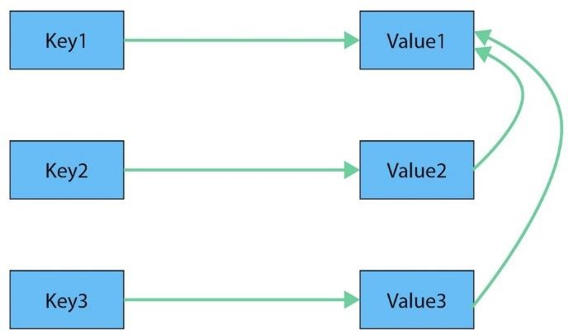
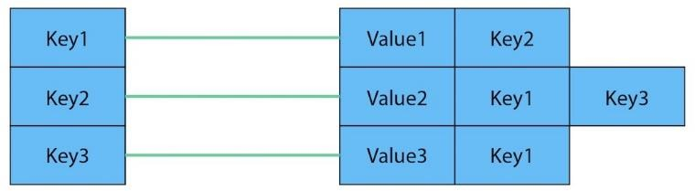
Key-Value Model
Key-Value as Graph

Slide 32
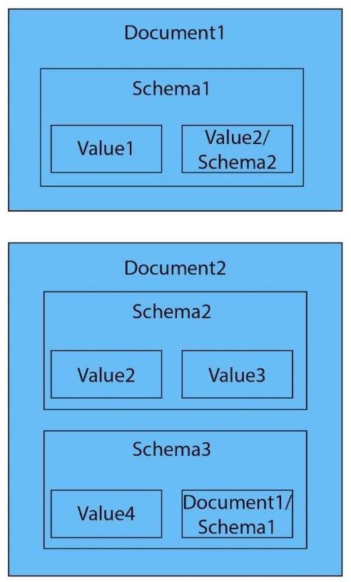
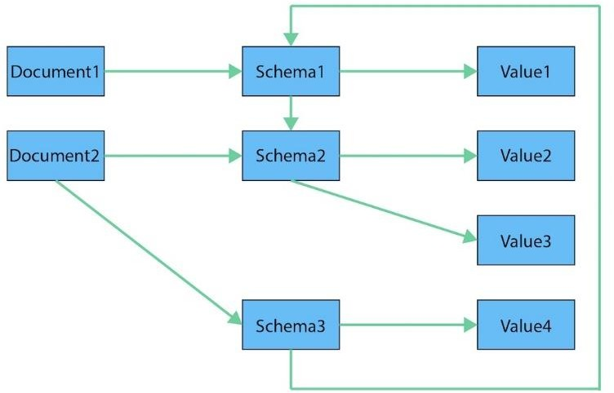
Document as Graph
Document Model

Slide 33

https://www.guru99.com/nosql-tutorial.html
https://redis.com/nosql/key-value-databases/
https://www.mongodb.com/scale/types-of-nosql-databases
https://www.kdnuggets.com/2021/02/understanding-nosql-database- types-column-oriented-databases.html
https://ravendb.net/articles/nosql-document-oriented-databases-detailed- overview

